Slide 1
Embrasure

Slide 2
Game Demo
https://dl.dropboxusercontent.com/u/273455493/cs%20125/da4/index.html

Slide 3
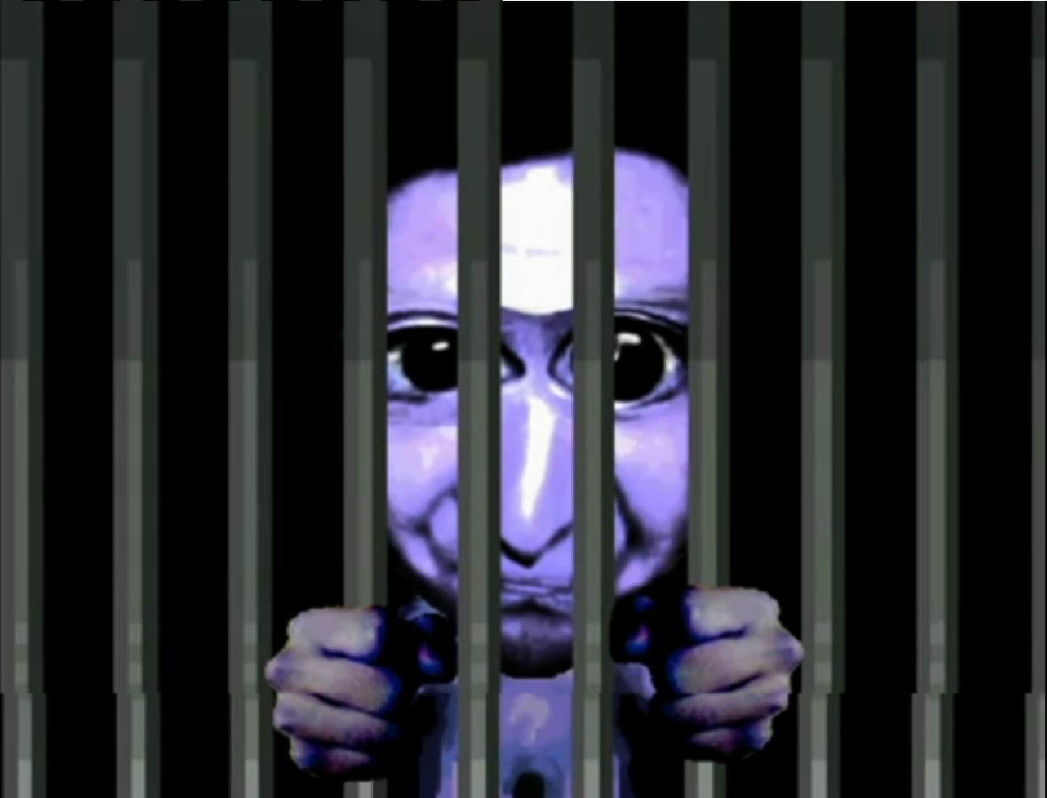
Overall Design Goals
Add more levels (2 to 3)
Add puzzles in addition to finding keys
Add custom art and sprites
Improve monster AI
Upgrade to Phaser 2.0

Slide 4
Group Roles
Liam McGhee – project manager, lead programmer
Faez Dabesta – level/puzzle designer
David Dolynuik – art/sound design, programming
Victor Calleja – level design, programming

Slide 5
Estimated Schedule
Week 1
Design/build level 1
Make any needed art/sound assets for level 1
Upgrade to Phaser 2.0
Week 2
Finish up level/puzzle/art design for level 1
Begin coding level 1
Week 3
Design/build level 2/3
Make any needed art/sound assets for level 2/3
Start/Finish Coding Level 2
Week 4
Start/Finish Coding Level 3
Prepare final presentation

Slide 6
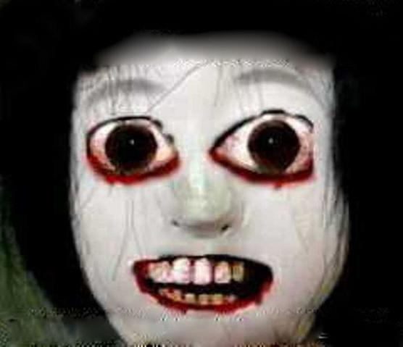
SPOOKY!!!!!

